Slide 1
AQUABOTS Aeropak
Final Assembly Review
Team 26061

Slide 2
Overview
1.0 Introduction
2.0 Post-ISR Changes
3.0 Verification Results
4.0 Lessons Learned & Next Steps
5.0 Budget
6.0 Deliverables
7.0 Summary
Notes:
Jamie

Slide 3
Introduction

Slide 5
Our Team
Jamie Ledbetter, Biosystems Engineering – Team Lead
Robert Wilkie, Aerospace Engineering – Procurement Lead
Alex Imrich, Aerospace Engineering
John Lopez, Electrical Engineering
Mayra Mendoza, Optical Engineering
Kama Henriques, Mechanical Engineering

Slide 6
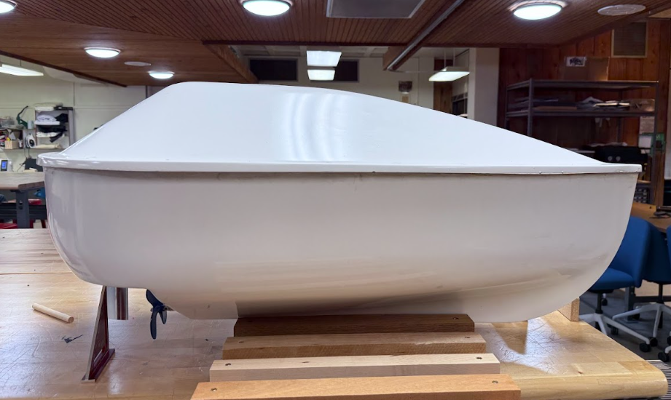
Project Summary
Purpose: Rapid, real-time environmental monitoring in marine and coastal environments
Deployment: Ocean-deployed drones self-orient within 1 minute and follow remotely set paths
Ground Station:
Live video stream from main drone
Real-time environmental data from all drones
GEO-overlay for spatial monitoring and mission control
Hull & Structure:
Self-righting, waterproof, impact-resistant design
Fiberglass enclosure protecting internal systems
Communication:
Starlink satellite antenna for continuous remote connectivity
Onboard Systems:
Jetson Nano – Controls motors, servos, and live video
ESP32 – Collects GPS, time, altitude, temperature, pH, and conductivity data
Image of AQUABOT Hull
Notes:
Jamie

Slide 7
Post-ISR Changes
(1-2 slides each, only include design changes from ISR to NOW)

Slide 8
Post-ISR Changes
Added Servo Mount
Reduction to One Battery
Pixhawk Integration to RC Boats
Replaced ESP32 with ESP32-S3
Tailscale Access
Modified Electronics Shelf
Action Items:
All Action Items Closed
Notes:
Jamie

Slide 9
Added Servo Mount
Notes:
Robert (Include photo of CAD)

Slide 10
RC Boats
Notes:
Alex - addition of pixhawks, include photo of pixhawk, and integration between ESC/Motor/Prop and ESP32.

Slide 11
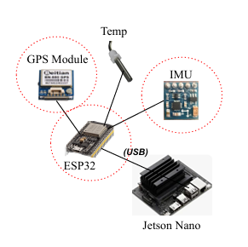
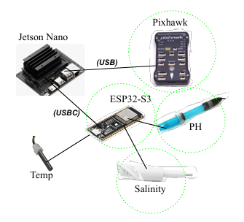
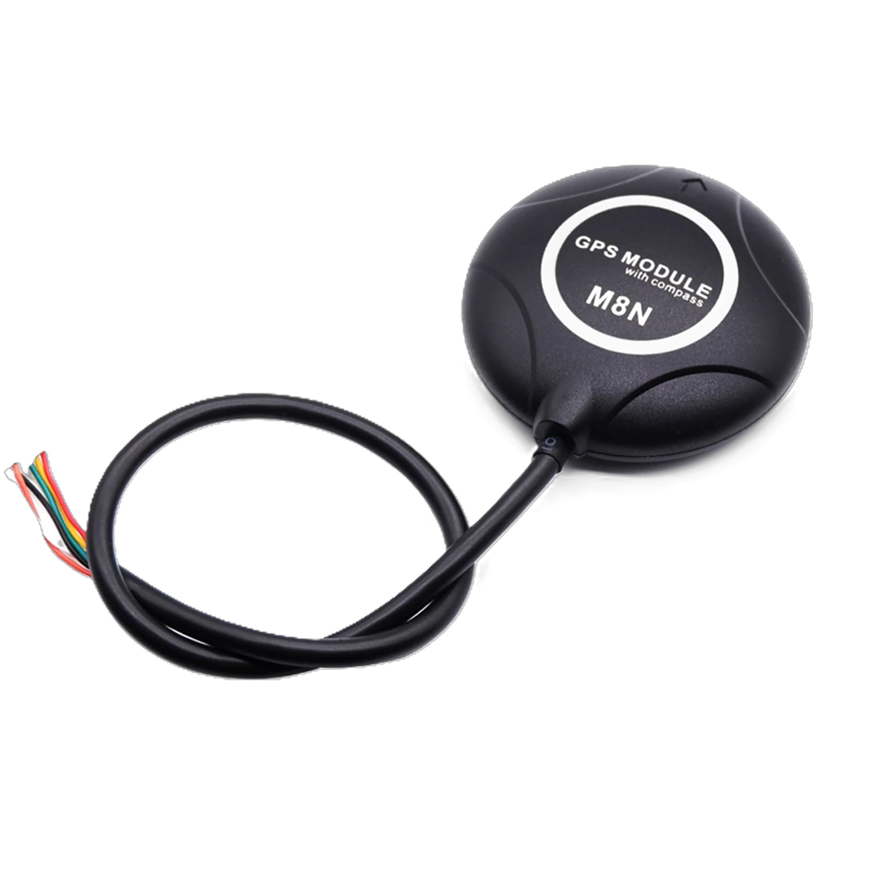
Sensor & Communication Integration (Jetson)
ISR: FAR:
Replaced ESP32 → ESP32‑S3 to support more reliable ESP‑NOW communication for the swarm system
Added Pixhawk to handle motor control, navigation, and sensor timestamping
Integrated final geo‑overlay sensors.
gps
* Main Hull configuration
Notes:
Mayra

Slide 12
Electronics Stack
Notes:
Kama (ISR CAD left → New CAD right)

Slide 13
Verification Results
Verification for each test should include 2-3 slides:
Test setup (with graphic, if possible)
Requirements verified by the test
Results (Not needed if testing incomplete at time of FAR)

Slide 14
Off-Water Navigation/Propulsion Test Setup
Tested, it runs
Notes:
John & Robert

Slide 15
Results
Notes:
John & Robert

Slide 16
Requirements Verified
Requirement | Status | Remaining Action
4.1.3 Stability | Pass
4.1.4 Speed | Pass
 | Pass
 | Partial Pass
Notes:
John & Robert - add requirements and fill

Slide 17
RC Boat Test Setup
Notes:
Alex

Slide 18
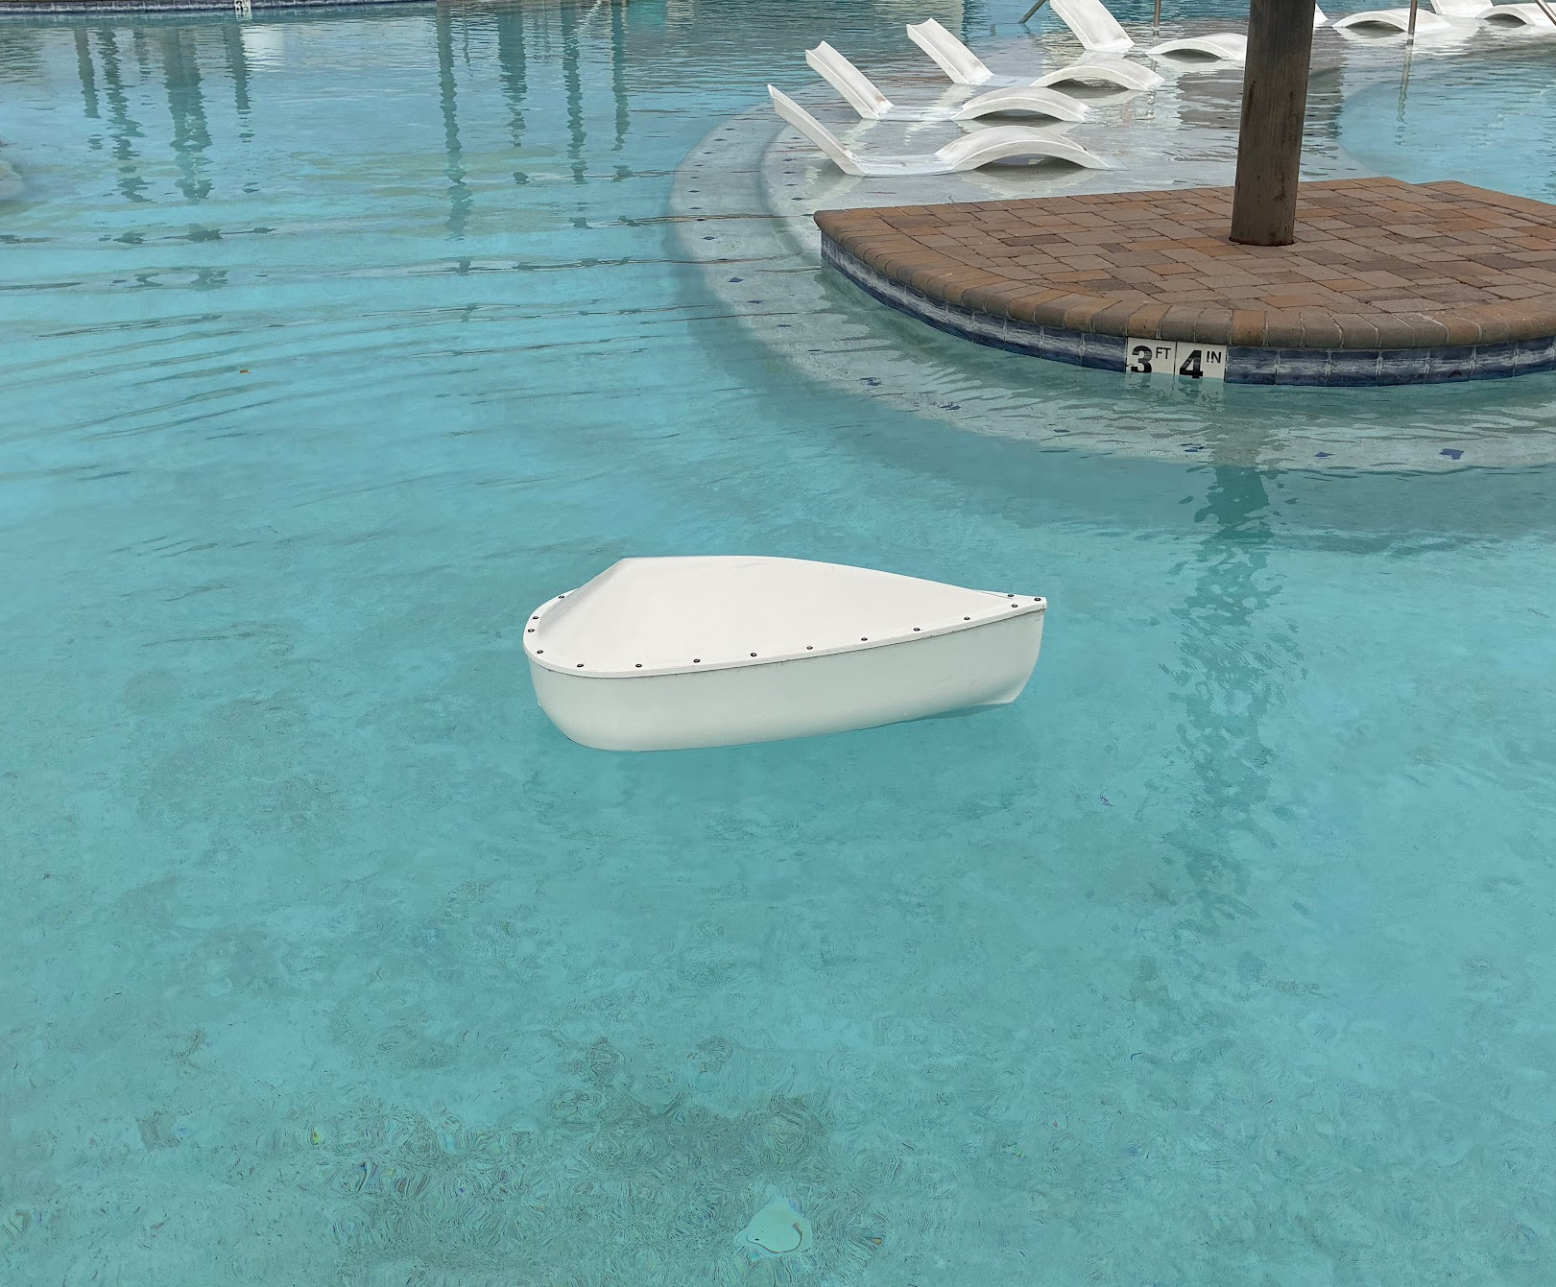

Self-Righting and Waterproofing Subsystem
Testing/Verification (5.1.3, 5.3.2)
Analysis of Torque due to Mass Offset
 | Approximate Center of Buoyancy (mm) | Assembly Center of Mass (mm) | Offset (mm) | Total Mass (kg) | Resulting Torque (N*m)
X (Roll) | 0 | 1.23 | -1.23 | 29.26 | -0.353
Y (Yaw) | -326.54 | -296.47 | -30.07 |  | 0.000
Z (Pitch) | -303.89 | -281.52 | -22.37 |  | -6.421
COM offset only results in a small change in equilibrium pitch
Calculated low COM indicates self-righting capabilities after modifications
Initial self-righting and waterproof testing successful
Extra waterproofing precautions: possible bilge pump implementation, upgraded washers, waterproof sealant
Final testing will be conducted before 3/30/2026
Image showing initial waterproof and self-righting testing
Notes:
Kama:
On left, comparison of COB to COM
It can be seen that COM is below the COM, suggesting self-righting capabilities after modifications
Initial self-righting tests were passed very convincingly
Also, there’s a small offset along the transverse axis which will be reflected by a slight change in pitch when sitting in the water
The offset in the longitudinal direction is negligible, meaning that no roll is expected due to added mass
Initial waterproof testing was also done with kimwipes, which was completely successful when:
Turning propeller shaft
Flipping
Holding underwater at different orientations
For extra waterproofing safety, several precautions have been taken (ordering upgraded washers, waterproof sealant, and a bilge pump)
After all of the components are integrated by March 23, final testing for both waterproofing and self-righting will be conducted soon after

Slide 19
End to End Remote Operation Test - Setup
System Set up:
Jetson connected to reliable Network
GUI hosted on Jetson
Tailscale was connected on Jetson.
Remote Access:
Eddy connected to tailscale from Ireland
Opened GUI through browser
http://100.67.1.26
Tested and Recorded:
Live Video Streaming
Real-time telemetry display
Remote control (record button)

Slide 20

Remote Operation Demo
Remote user (Ireland) successfully accessed and controlled GUI
All sensors integrated and displayed in real time (GPS, IMU, temperature, pH, salinity)
Live video streamed with < 30 ms latency
Remote recording triggered; video and telemetry saved on Jetson
Notes:
Mayra - Add video with Eddy, Summarize results in bullet points

Slide 21
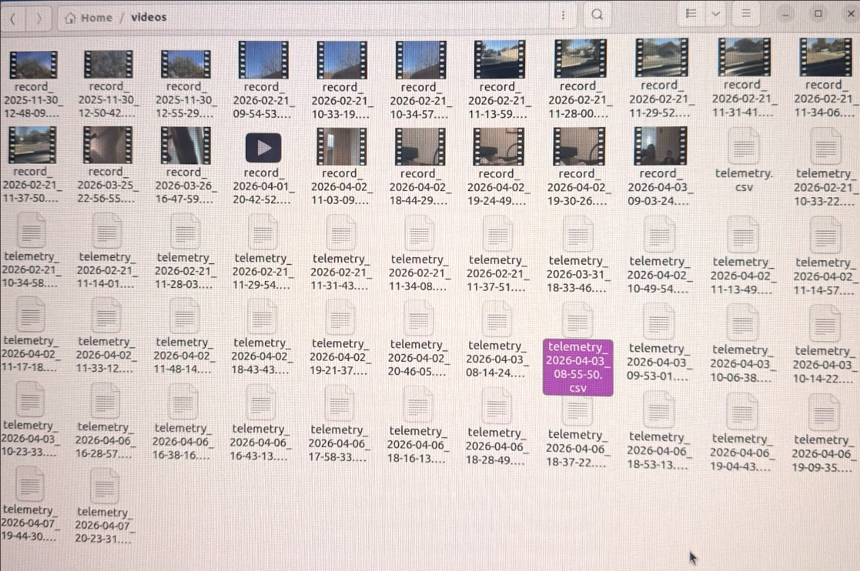
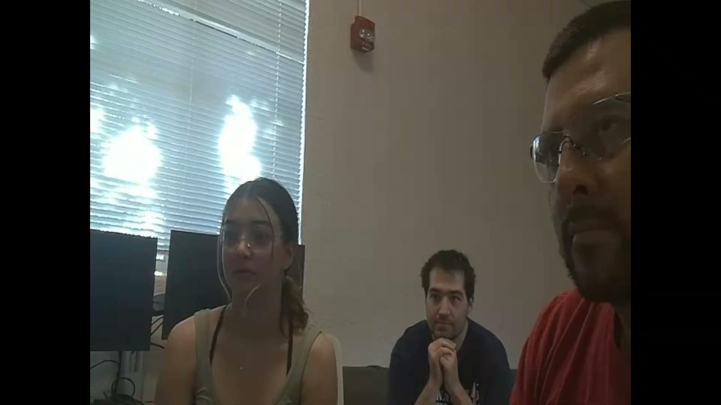
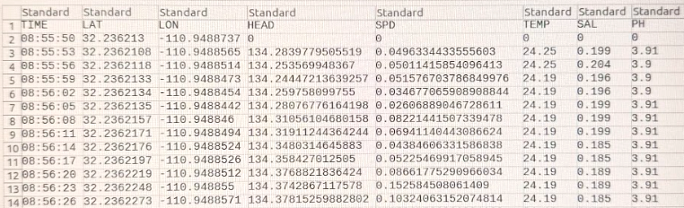
Remote Recording and Data Synchronization
Remote user triggered recording from GUI
Video and telemetry saved on Jetson
Synched and saved under same file.
Confirms end to end remote data collection and control.

Slide 22
Results
Requirement | Status | Remaining Action
5.1.6 Data Collection | Pass
5.1.7 Data Mapping | Pass
5.4.3 Data Relay | Pass
5.4.4 Satellite Uplink | Pass
5.4.5 Display | Pass
5.4.1 Autonomy & Control | Partial Pass | Waypoint & Throttle Validation
Notes:
Mayra - Add in other requirements that have been fully/partially verified

Slide 23
Communication Subsystem Verification Plan
Notes:
John

Slide 24
Results
Requirement | Status | Remaining Action
5.3.1 Survivability | ◐ Comms Pass (0% loss calm) | Test with wave / stormy conditions on lake
5.4.3 Data Relay | ◐ Partial (Position✓) | Integrate Jamie's sensor pipeline; demo full telemetry stream
4.4.1 Autonomy & Control | ◐ Partial (commands ✓) | Implement formation control (Step 6); pool demo all 4 formation types
5.4.2 Inter-Drone Comms | ✓ ESP-NOW verified | Validate 100m range in pool environment
5.4.6 Swarm Control | ◐ ESP-NOW layer done | Bridge ESP32→ Jetson via MAVLink/serial; implement MQTT pub/sub ≥1 Hz, verify <1s latency
Notes:
John - Update from ISR

Slide 25
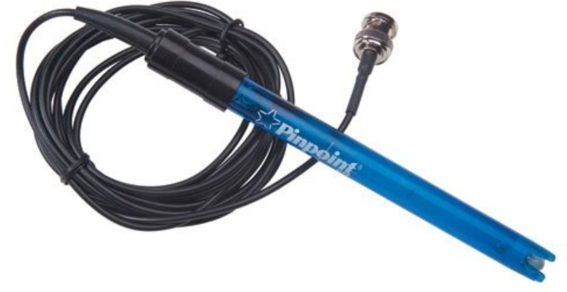
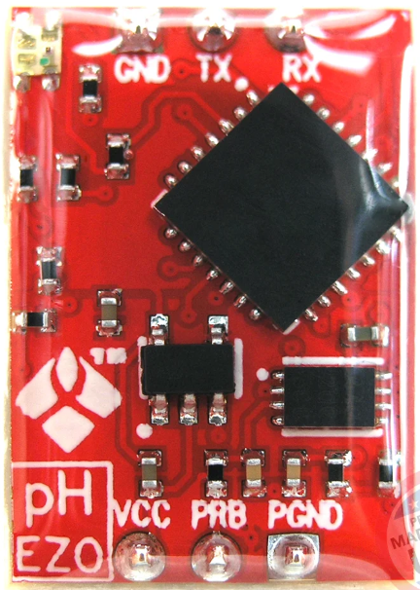
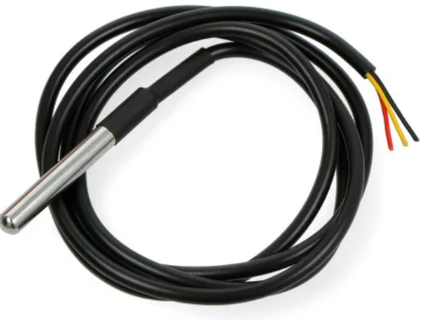
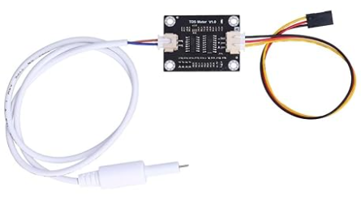
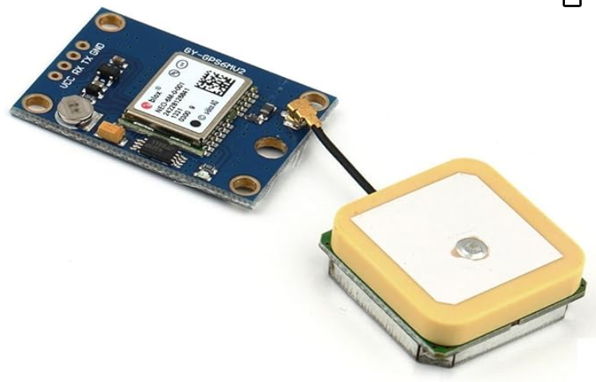
Sensors Verification Plan
pH Probe
CSV File in Format:
Date,Time, Lat., Long., Speed, GPS Fix, Temp., Cond., pH.
Temperature Probe
In order to verify full functionality of sensor suite, sensors will be tested using known, calibrated substances of varying temperature, salinity, and pH. These values will be confirmed at the ground station GUI, and necessary calibration curves will be constructed and applied.
Conductivity Probe
GPS Module
Notes:
Jamie

Slide 26
Results
Requirement | Status | Remaining Action
5.1.6 Data Collection | Pass
5.4.5 Display | Pass
5.2.4 Payload Mounts | Pass
5.3.2 Waterproofing: | Partial Pass
Notes:
Jamie

Slide 27
Sensor Requirements Verification
5.1.6 Data Collection: Each AQUABOT drone shall measure temperature, salinity, pH, and capture visual imagery at a minimum of 1080p resolution, 30 fps.
5.4.5 Display: The display shall show half the display with Geo-overlay and the other half will display live-streaming.
5.2.4 Payload Mounts: The hull shall provide standardized, sealed mounts for Starlink terminal, battery, and sensor payload.
5.3.2 Waterproofing: Each aquatic AQUABOT drone shall meet IP68 ingress protection standards IAW IEC 60529:1989 + AMD1:1999 CSV. Waterproof components shall be tested in 1.5 m depths to ensure compliance.
Notes:
Jamie

Slide 28
Overall Performance Review
Notes:
Jamie

Slide 29
Lessons Learned & Next Steps

Slide 30
Notes:
Kama

Slide 31
Budget

Slide 32
Cost Analysis
Notes:
Robert

Slide 33
Deliverables
Notes:
Jamie

Slide 34
Deliverables
Notes:
Jamie

Slide 35
Summary
Notes:
Jamie

Slide 36
Summary

Slide 37
Questions & Discussion
Notes:
17

